Slide 1
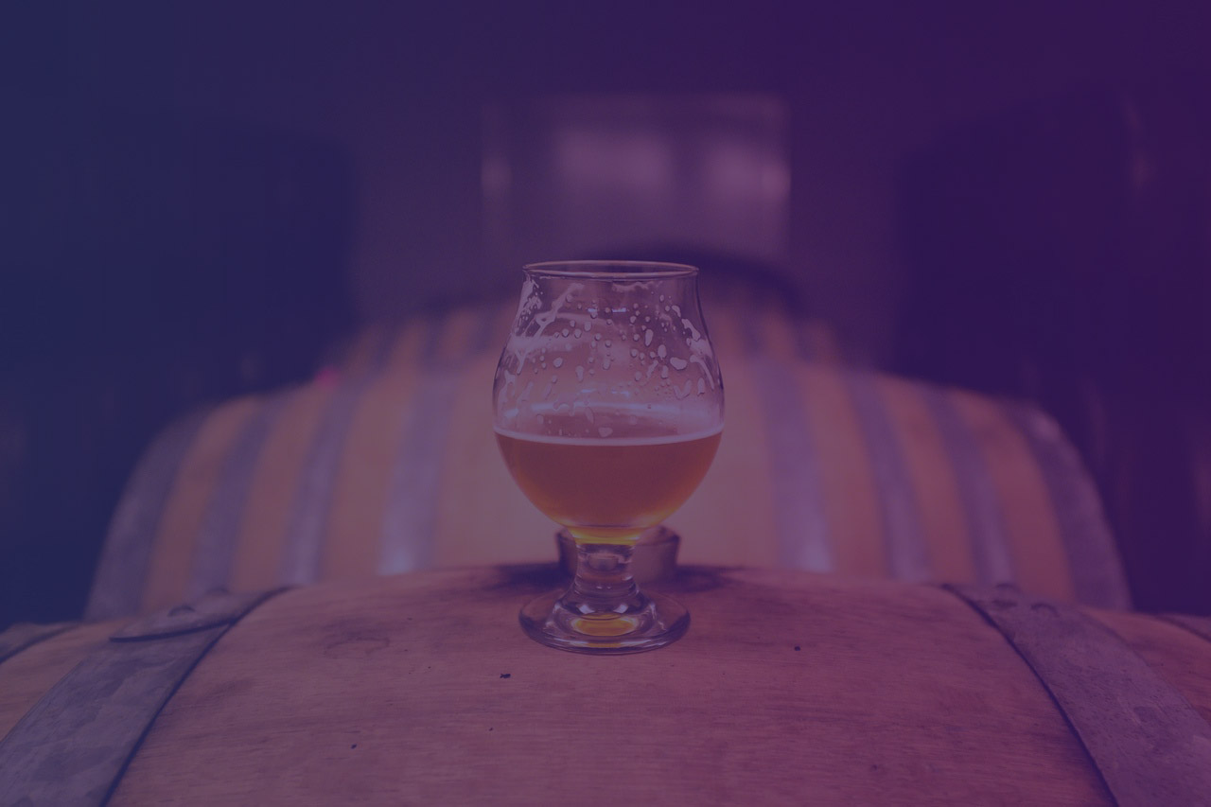
Key Rock
By Lauren Kiss, Jack Rothrock, and Alexander Nanji

Slide 2
Key Rock Business Visual
5
Microbrewers
2
Countries
1-3
Beers
Notes:
Key Rock works on a consignment basis, rather than drop-ship. This means they pre-purchase stock from microbrewers, who hold the stock and fulfill the orders. Currently, Key Rock is working with 5 microbrewers from 3 different countries: Germany, Belgium, and the Netherlands. Each microbrewer has 1-3 beers available for purchase, with the ability to change their product-offerings as frequently as they would like.

Slide 3
KeyRock.Com
Profiles and Purchases
Basic Information
Browsing and Shopping Cart
Metrics
Notes:
On Key Rock’s website, both microbrewers and customers create profiles. These profiles include basic and pertinent information, such as age and mailing information for customers, and beers available for sale and contact information for microbrewers. Customers can leave reviews about and browse for beers, and add them to their shopping cart for purchase. Microbrewers can view metrics on their beer sales, as well as update their product offerings. Transactions are managed by a third-party, Stripe, and invoices occur through an outside site.

Slide 4
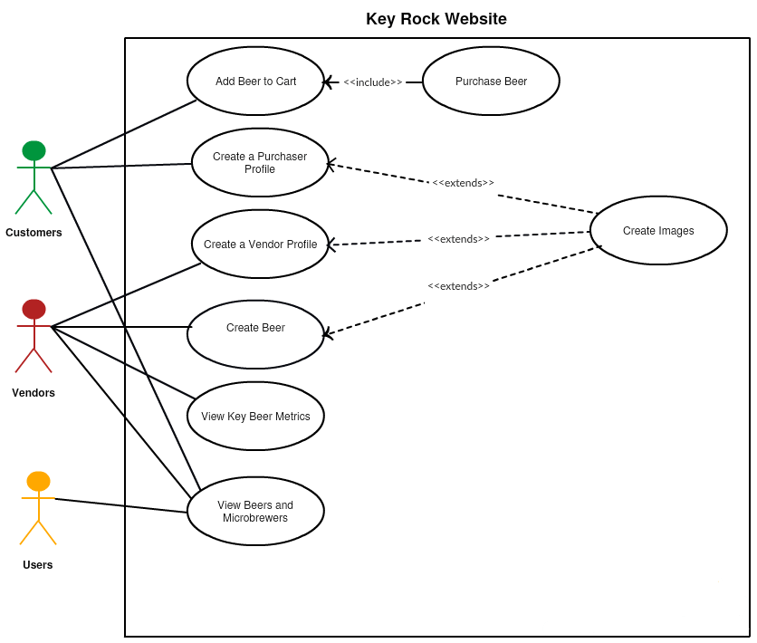
Notes:
Brief explanation

Slide 5
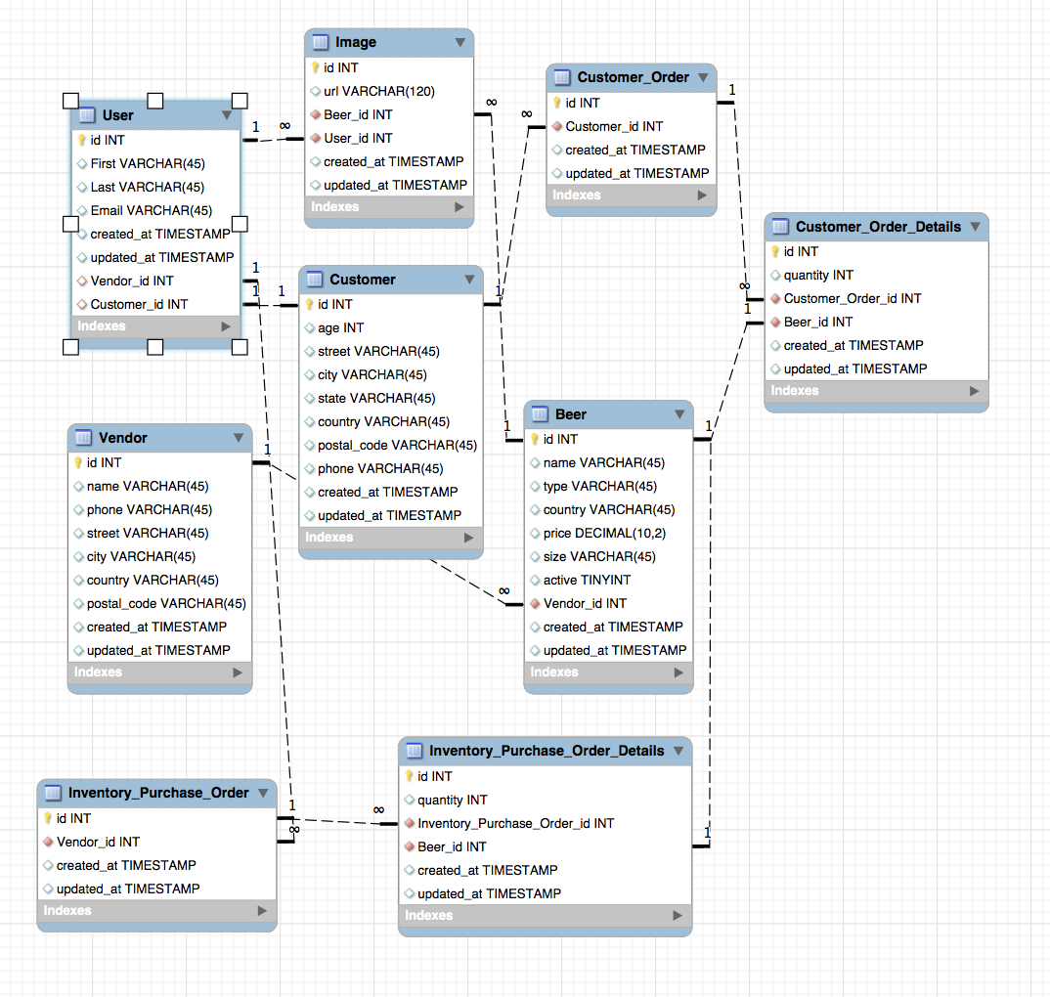
Notes:
Brief explanation

Slide 6

Business Questions
Creating Opportunities for Data-Driven Decisions
Marketing
Create marketing campaigns and target customers in the most effective manner to increase engagement and retention.
Product Management
Optimize product offerings to generate higher sales and fuel growth.
Sales
Advance relationships with top partners and identify new partners to further develop the company.

Slide 7
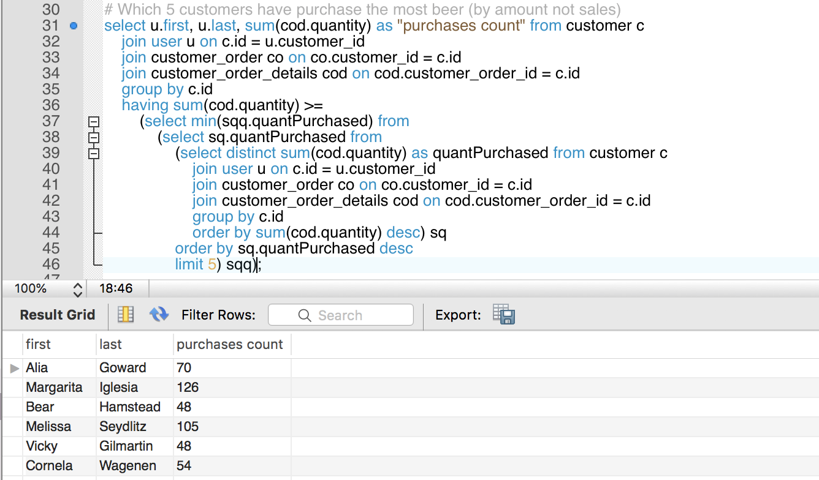
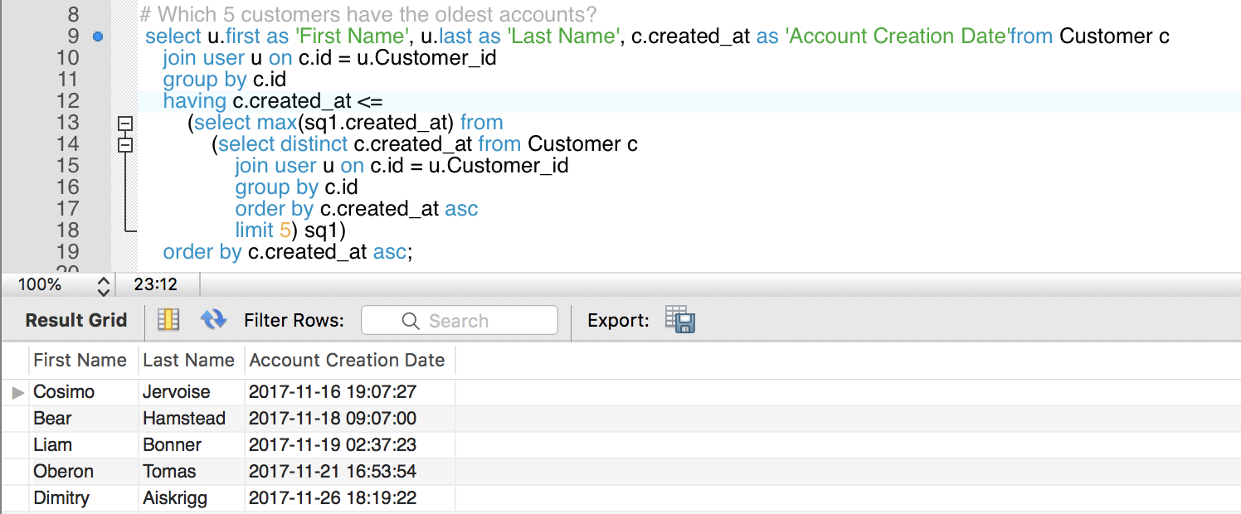
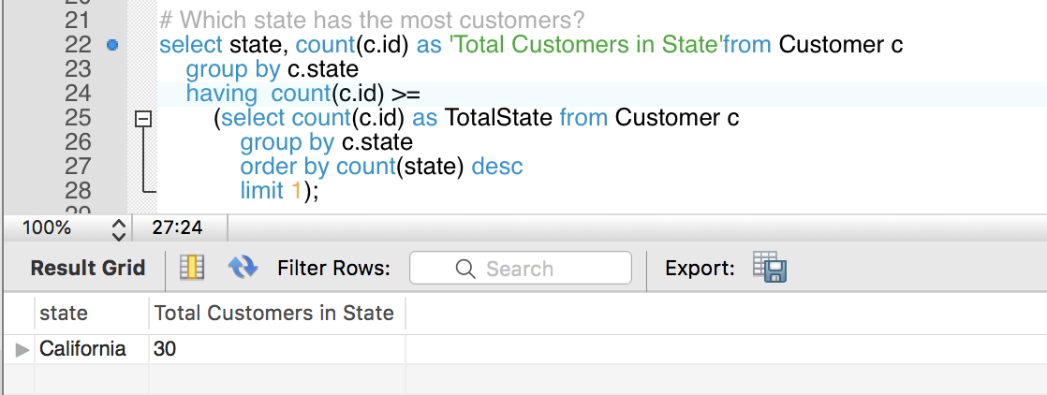
MARKETING
Cosimo Jervoise
Bear Hamstead
Which 5 customers have purchased the most beer?
Which state has the most customers?
Liam Bonner
Oberon Tomas
Dimitry Aiskrigg
Vicky Gilmartin
California
Alia Goward
Margarita Iglesia
Bear Hamstead
Which 5 customers have the oldest accounts?
Melissa Seydlitz
Cornela Wagenen

Slide 8
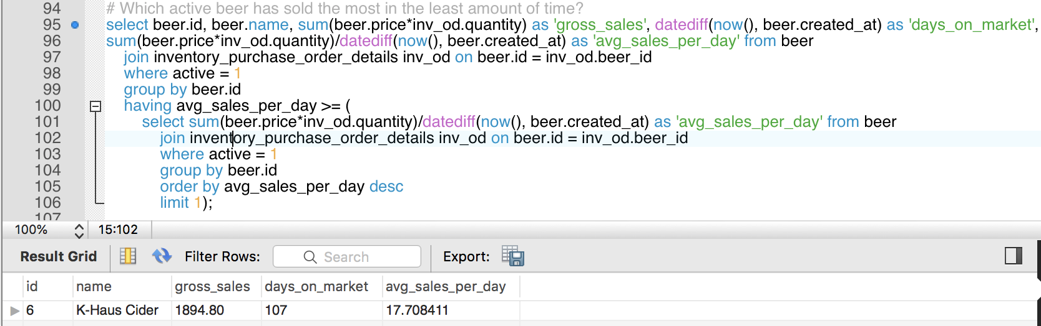
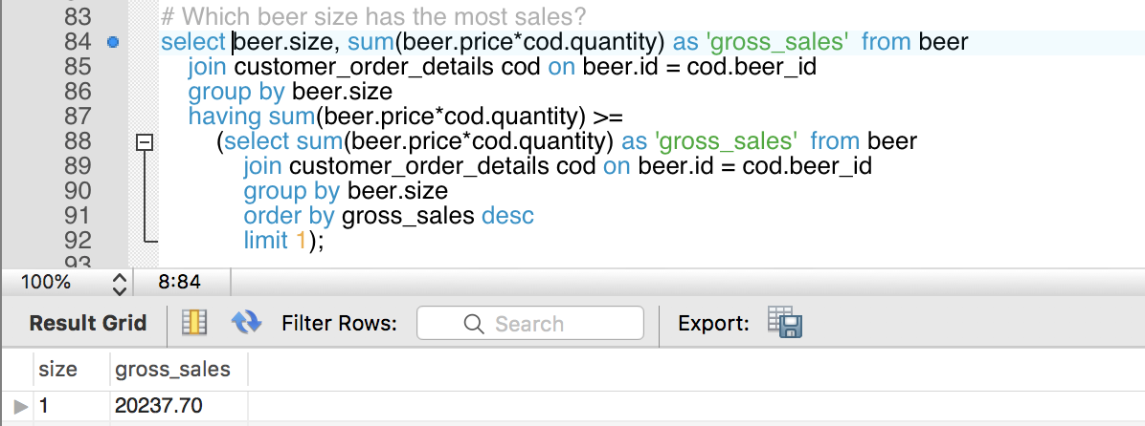
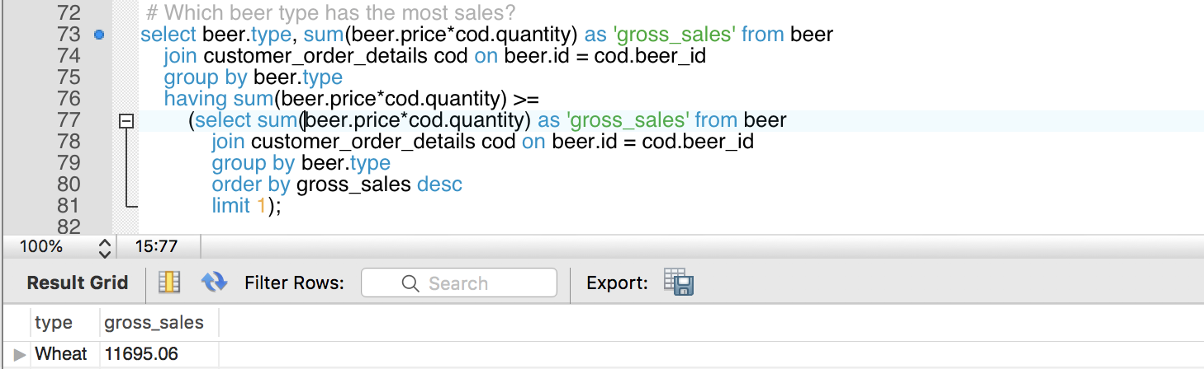
PRODUCT MANAGEMENT
Which beer type has the most sales?
K-Haus Cider
Which beer size has the most sales?
Wheat
Size 1
Which active beer has sold the most in the least amount of time?

Slide 9
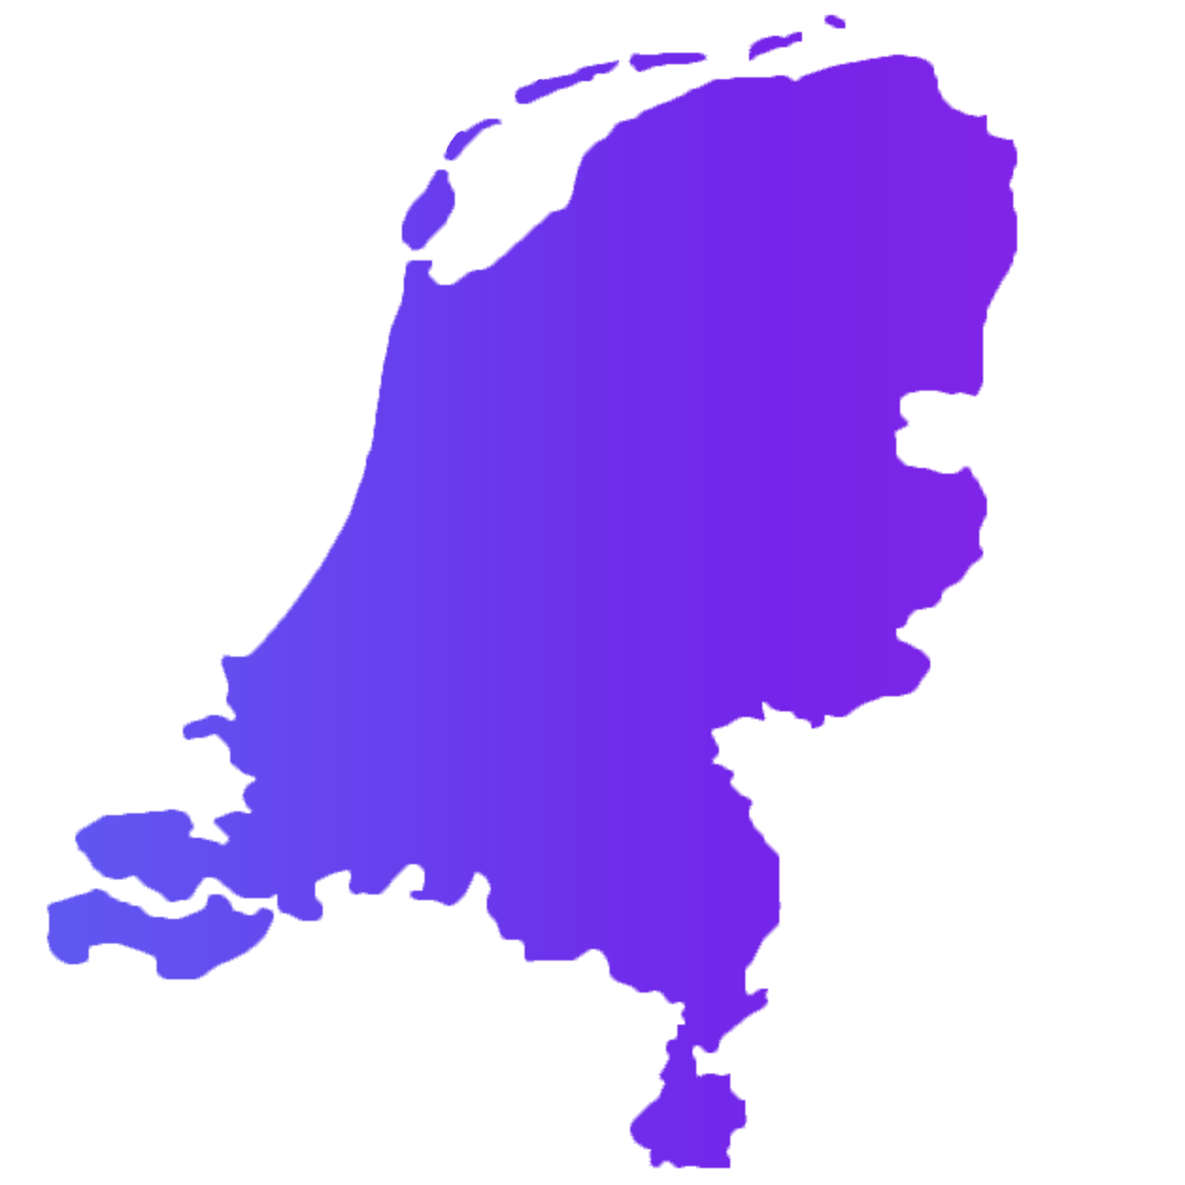
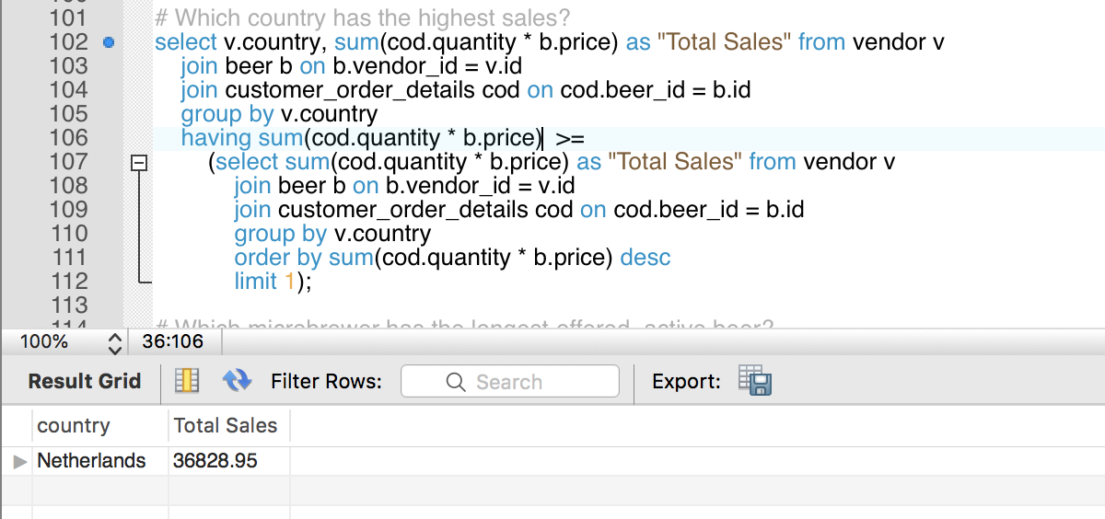
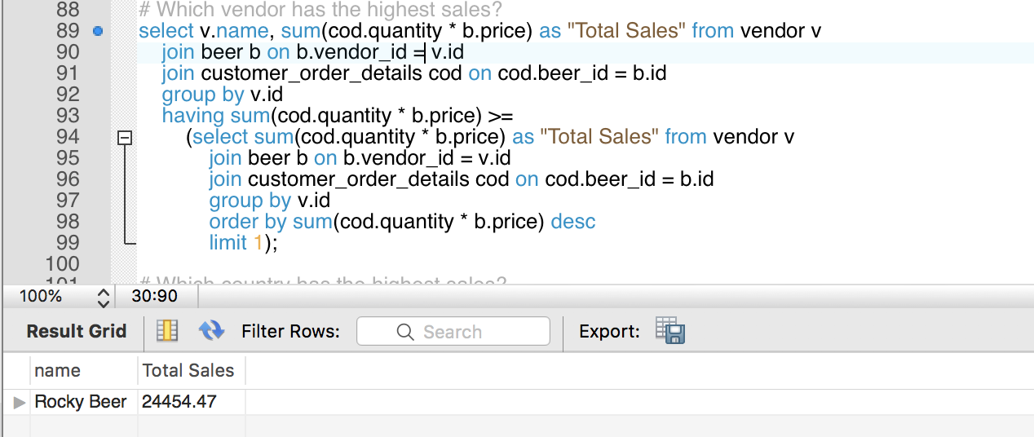
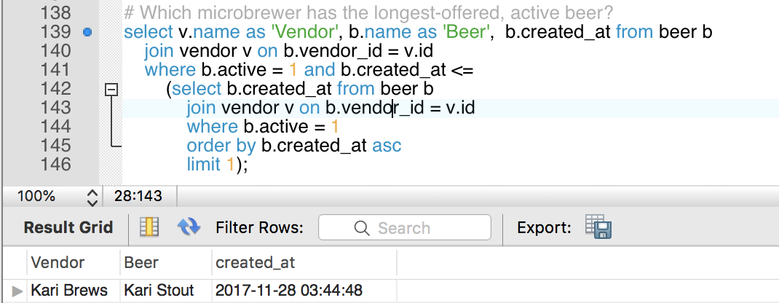
SALES
The Netherlands
Which microbrewer has the highest sales?
Which microbrewer has the longest-offered, active beer?
Rocky
Beer
Kari Brews
Which country has the highest sales?

Slide 10
Key Learnings
Jack
Inventory
Order Details
No inclusion of an inventory table.
SQL
Project
The decision to include an order details table.

Slide 11
Key Learnings
Lauren
Time
Details
The time-intensive nature of SQL.
SQL
Project
The detail-heavy nature of SQL.

Slide 12
Key Learnings
Xander
Database Schema
Timestamps
Using id for the join, instead of table_id.
SQL
Project
The importance of created_at and updated_at.

Slide 13
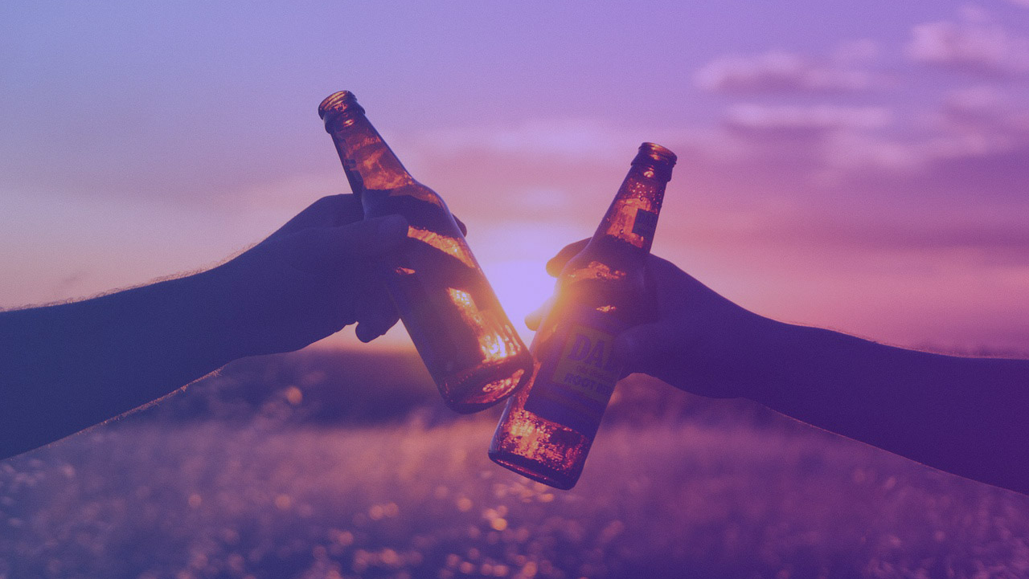
THANK YOU
Questions?

